Slide 1
Introduction
Now that the system is operational, the real test begins. The key question is whether or not the system meets user expectations and provides support for business objectives
Systems must be maintained and improved continuously to meet changing business demands, and users constantly require assistance
Notes:
4

Slide 2
System Operation and Support

Slide 3
Overview of Systems Support and Maintenance
The systems operation and support phase begins when a system becomes operational and continues until the system reaches the end of its useful life.
After delivering the system, the analyst has two other important tasks: he or she must support users and provide necessary maintenance to keep the system operating properly

Slide 4
User Support Activities
User Training
  You already are familiar with initial user training that is performed when a new system is introduced
  In addition, new employees must learn how to use the company’s information systems
  User training package
  Training users about system changes is similar to initial training

Slide 5

User Support Activities
Help Desk
  Also called information center (IC)
  Enhance productivity and improve utilization of a company’s information resources

Slide 6
User Support Activities
Help Desk
  perform the following tasks:
    Show a user how to create a data query or report that displays specific business information
    Resolve network access or password problems
    Demonstrate an advanced feature of a system or a commercial package
    Help a user recover damaged data

Slide 7
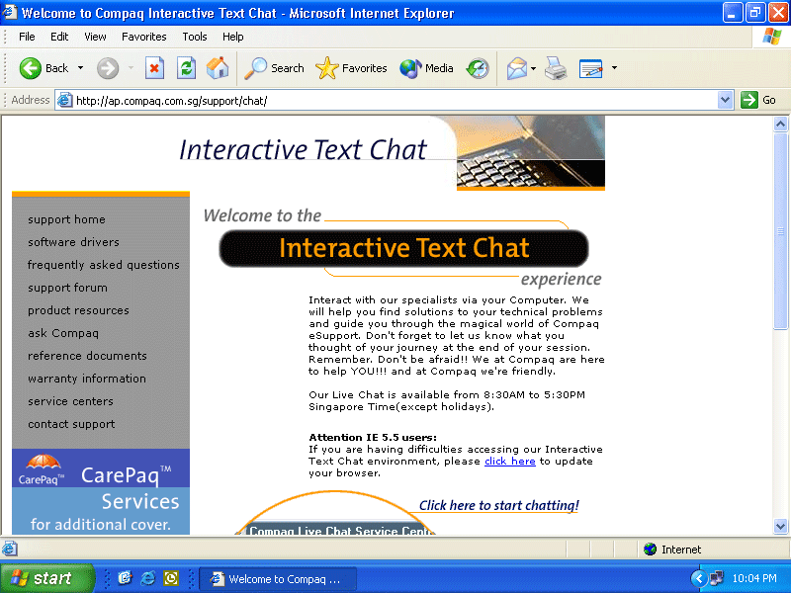
User Support Activities
Help Desk
  In addition to functioning as a valuable link between IT staff and users, the help desk is a central contact point for all IT maintenance activities
  Interactive support also can be delivered in the form of an online chat
  Virtual Classroom

Slide 8
Maintenance Activities
The systems operation and support phase is an important component of TCO (total cost of ownership) because ongoing maintenance expenses can determine the economic life of a system
Operational costs
Maintenance expenses
Maintenance activities

Slide 9
Maintenance Activities
Four types of maintenance tasks can be identified
Corrective maintenance
Adaptive maintenance
Perfective maintenance
Preventive maintenance

Slide 10
Maintenance Activities
Corrective Maintenance
  Diagnoses and corrects errors in an operational system
  You can respond to errors in various ways, depending on nature and severity of the problem
  For more serious situations, a user submits a systems request with supporting evidence

Slide 11
Maintenance Activities
Adaptive Maintenance
  Adds enhancements to an operational system and makes the system easier to use
  The procedure for minor adaptive maintenance is similar to routine corrective maintenance
  Can be more difficult than new systems development because the enhancements must work within constraints of an existing system

Slide 12
Maintenance Activities
Perfective Maintenance
  Involves changing an operational system to make it more efficient, reliable or maintainable
  Can improve system reliability
  Cost-effective during the middle of the system’s operational life
  Two techniques you can use in perfective maintenance are reverse engineering and reengineering

Slide 13
Maintenance Activities
Preventative Maintenance
  Reverse engineering includes changes to an operational system that reduce the possibility of future problems
  Preventive maintenance requires analysis of areas where trouble is likely to occur
  Competes for IT resources along with other projects, and sometimes does not receive the high priority that it deserves

Slide 14
Managing Systems Operation and Support
During this phase, companies use various strategies, which can include a maintenance team, a process for managing maintenance requests and priorities, a configuration management process, and a maintenance release procedure
In addition, firms can use version control and baselines to track system releases and analyze the system’s life cycle

Slide 15
Managing Systems Operation and Support
Maintenance Team
  Analysis
  Synthesis
  Some organizations that have separate maintenance and new systems groups rotate people from one area to the other
  One disadvantage of rotation is that it increases overhead costs
  The training value of maintenance work outweighs the other factors

Slide 16
Managing Systems Operation and Support
Managing Maintenance Requests
  System administrator
  Step 1: maintenance request
  Step 2: initial determination
  Step 3: final disposition of the request
  Step 4: assignment of maintenance tasks
  Step 5: user notification

Slide 17
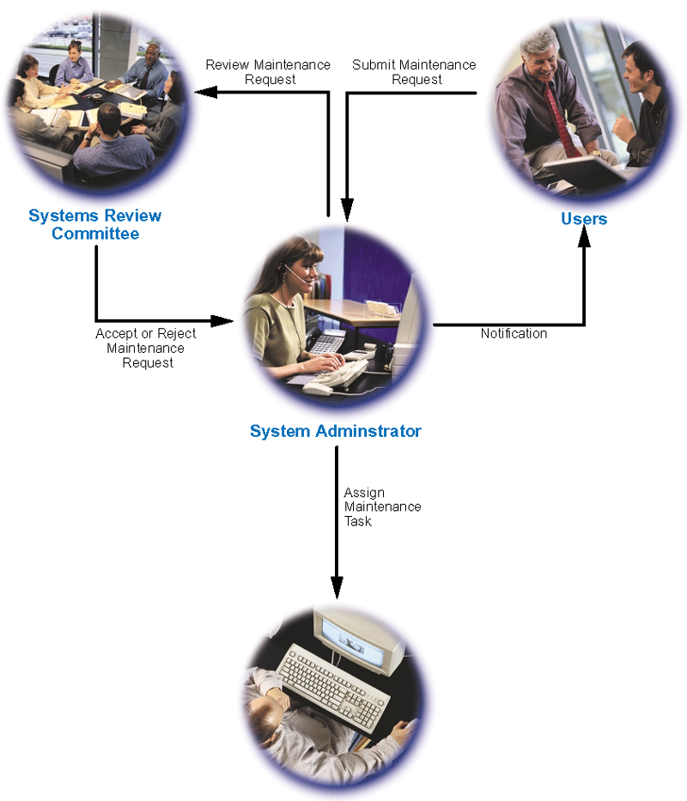
Managing Systems Operation and Support
Managing Maintenance Requests

Slide 18
Managing Systems Operation and Support
Establishing Priorities
  Systems review committee separates maintenance requests from new systems development requests when evaluating requests and setting priorities
  Many believe that evaluating projects together leads to the best possible decisions
  Neither approach guarantees an ideal allocation between maintenance and new systems development

Slide 19
Managing Systems Operation and Support
Configuration Management
  Configuration management (CM)
  As enterprise-wide information systems grow more complex, configuration management becomes critical
  Most maintenance projects require documentation changes

Slide 20
Managing Systems Operation and Support
Maintenance Releases
  Maintenance release methodology
  Maintenance release
  A numbering pattern distinguishes the different releases
  Reduces the documentation burden
  But new features or upgrades are available less often
  Service packs

Slide 21
Managing Systems Operation and Support
Version Control
  Version control is the process of tracking system releases
  Systems librarian
  Many companies use software such as Merant’s PVCS Version Manager

Slide 22
Managing Systems Operation and Support
Baseline
  The three types of baselines are:
  Functional baseline
  Allocated baseline
  Product baseline

Slide 23
Managing System Performance
A system’s performance directly affects users who rely on it to perform their job functions
To ensure satisfactory support for business operations, the IT department monitors current system performance and anticipates future needs
Benchmark testing

Slide 24
Managing System Performance
Capacity Planning
  Most important, you need an accurate forecast of future business activities
  If new business functions or requirements are predicted, you should develop contingency plans based on input from users and management

Slide 25
System Obsolescence
Even with solid support, at some point every system becomes obsolete
Signs:
  The system’s maintenance history indicates that adaptive and corrective maintenance is increasing steadily.
  Operational costs or execution times are increasing rapidly, and routine perfective maintenance does not reverse or slow the trend

Slide 26
System Obsolescence
Signs:
  A software package is available that provides the same or additional services faster, better, and less expensively than the current system
  New technology offers a way to perform the same or additional functions more efficiently
  Maintenance changes or additions are difficult and expensive to perform
  Users request significant new features to support business requirements

Slide 27
System Obsolescence
Systems operation and support continues until a replacement system is installed
At some point in a system’s operational life, maintenance costs start to increase, users begin to ask for more features and capability, new systems requests are submitted, and the SDLC begins again

Slide 28
Facing the Future: Challenges and Opportunities
The only thing that is certain about the future is continuous change
Change itself is neither good nor bad — the real issue is how people and companies deal with the challenges and opportunities that are bound to occur

Slide 29
Facing the Future: Challenges and Opportunities
Predictions
  It is clear that companies will continue to face intense competition and global change, especially in the wake of economic, social, and political uncertainty
  Although disruptions will occur, technology advances will spur business growth and productivity

Slide 30
Facing the Future: Challenges and Opportunities
Predictions
  It is interesting to note that some firms, such as ZONAR Corporation, believe that computer systems eventually will become so powerful and user-friendly that people will create information applications easily and without technical assistance
What does seem clear is that the future world of IT must be envisioned, planned, and created by skilled professionals

